Slide 1
Problem
Three particles with charges q=+2Q, Q2=-2Q, and q3=-4Q, each a distance d from the origin. What net electric field is produced at the origin?

Slide 2
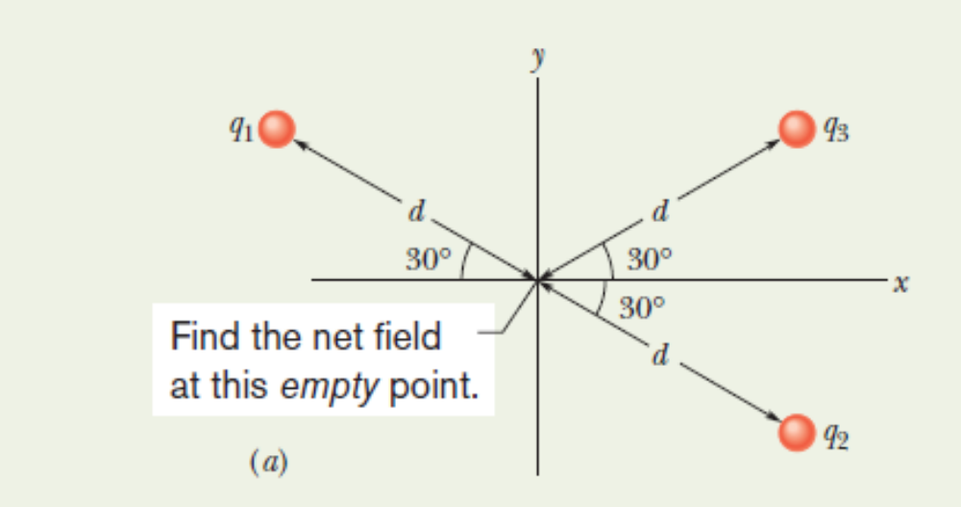
Problem

Slide 3
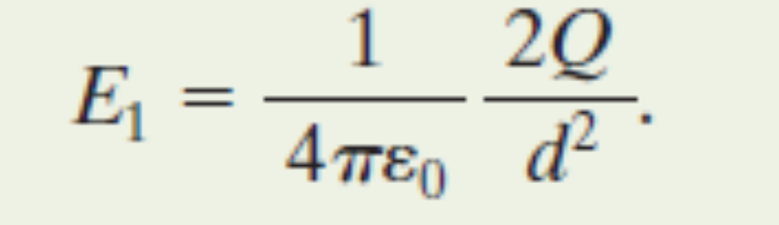
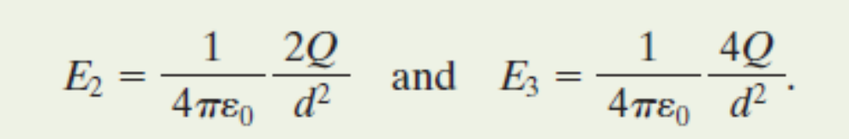
Solution

Slide 4
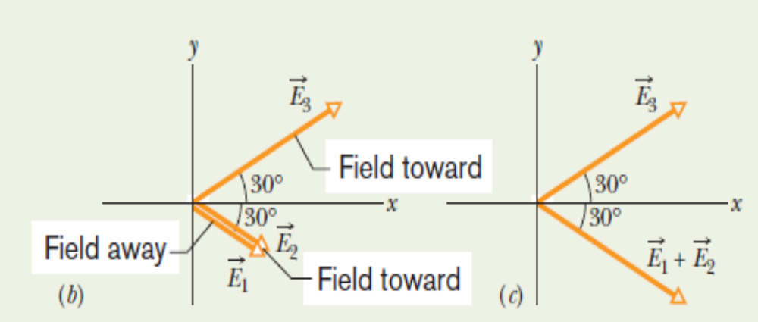
Problem

Slide 5
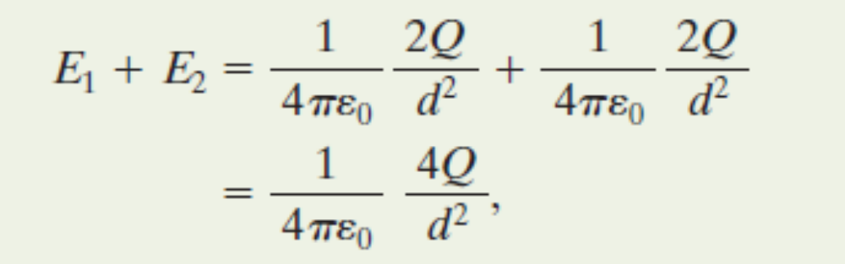
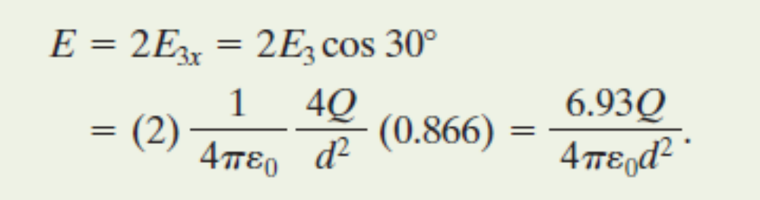
Solution

Slide 6
Where are you safe during a thunderstorm?
In a car or
Outdoors

Slide 7
Where are you safe during a thunderstorm?
In a car or
Outdoors

Slide 8
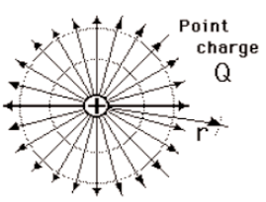
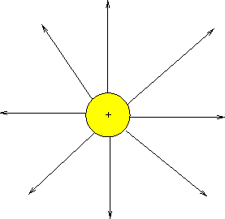
Which field is stronger?
A B

Slide 9
Which field is stronger?
A B

Slide 10
Electric Field for a Point Charge
Using E=F/q_{o} and Coulomb’s Law prove:
E = k Q
______
r²
where Q is the central charge.

Slide 11
Example 2
A test charge of +3µC is located 5m to the east of a -4µC charge.
A) Find the electric force felt by the test charge.
B) Find the electric field at that location.
Answer: 4.32x10⁻³ N, 1.44 x 10³ N/C along the –x axis.

Slide 12
Example 3
If a test charge is moved to a location three times as far as its original location, how does the electric field change?
Inverse-Square Law says… 1/9

Slide 13
Example 4
Calculate the electric field felt by a positive test charge located half way between a charge of +1C and a charge of -3C, that are 2m apart.
Answer: 3.6 x 10¹⁰ N/C (toward the -3C charge)

